Slide 1
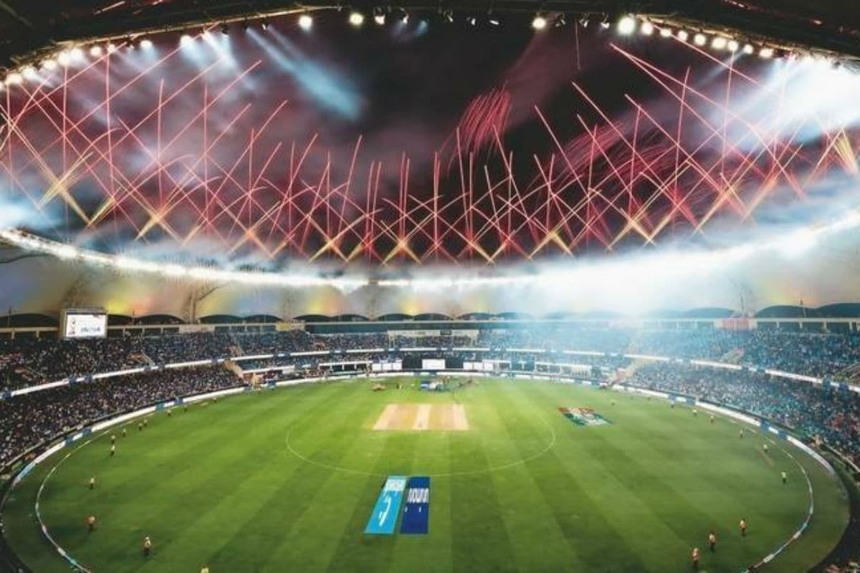


Slide 2
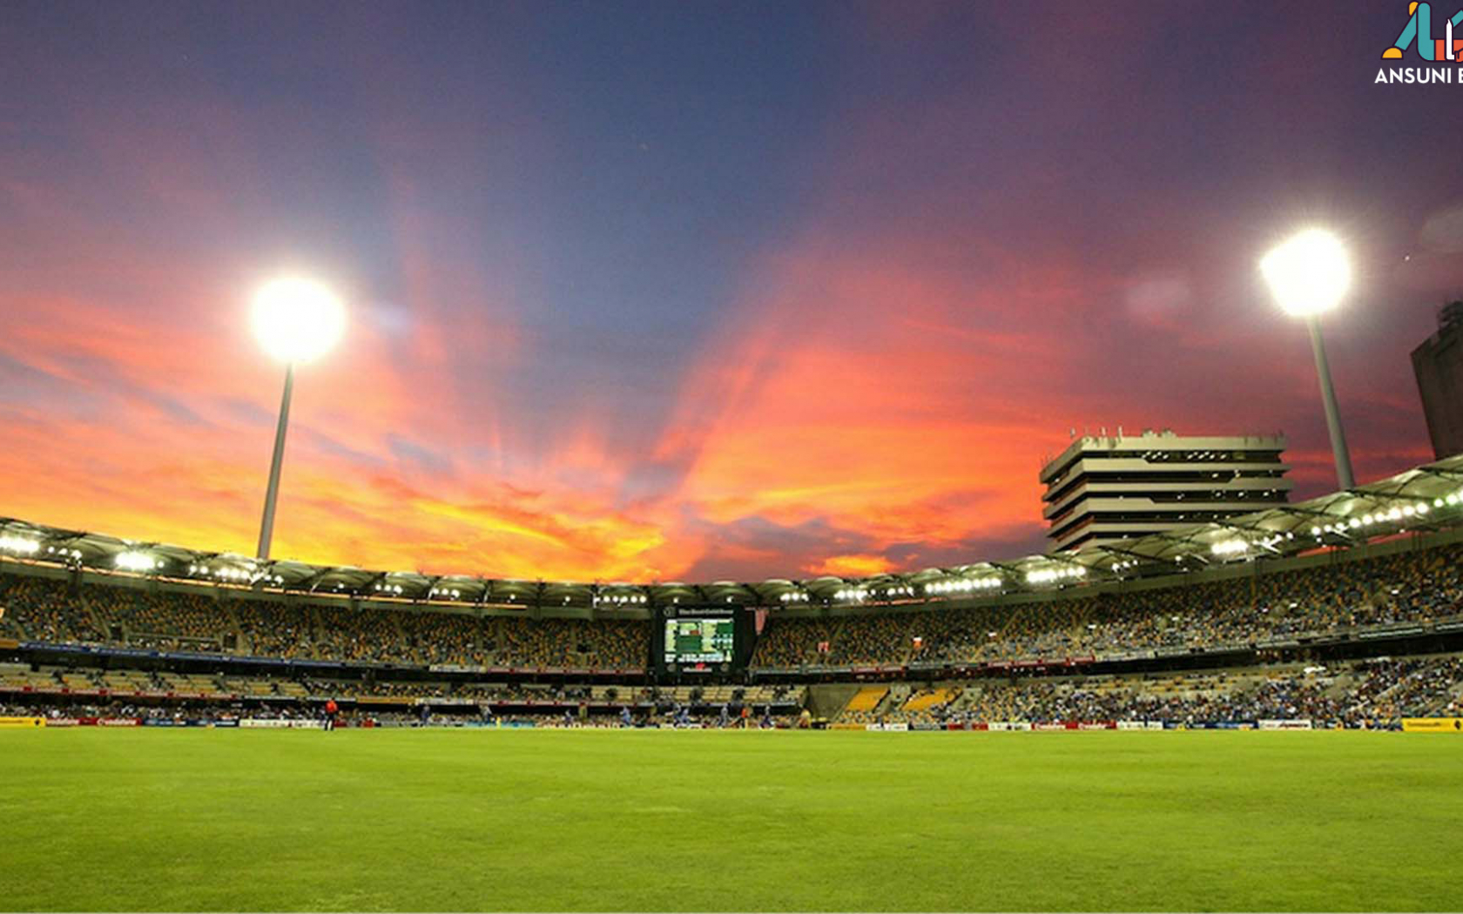

IPL Visualization Assignment
NOTE:
To change images on this slide, select a picture and delete it. Then click the Insert Picture icon
in the placeholder to insert your own image.
Consolidated data for all seasons (2008 – 2017)
- Darshan Lama

Slide 3
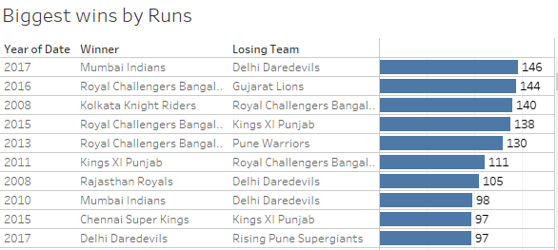
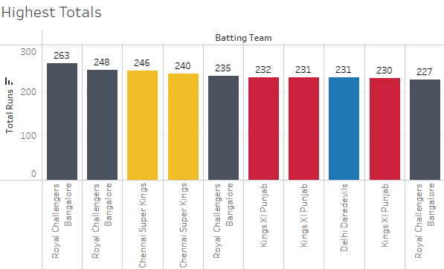
Mumbai Indians leads the chart with the biggest wins by runs
MATCH STATISTICS
And Royal Challengers Bangalore has the record for the highest total runs

Slide 4
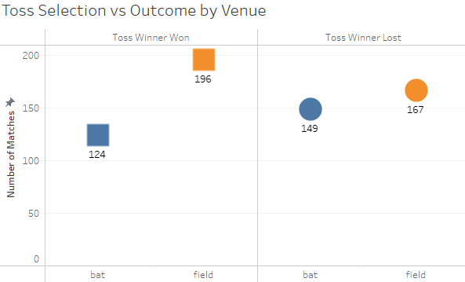
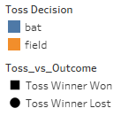
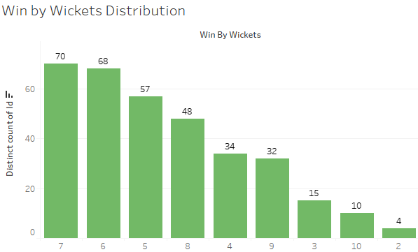
Team winning the toss and choosing to field won more matches
MATCH STATISTICS
Most of the win by wickets were for teams that took 5-7 wickets.

Slide 5
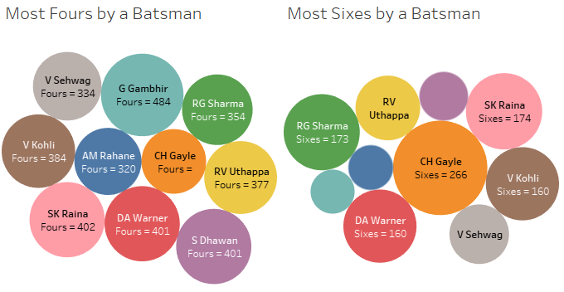
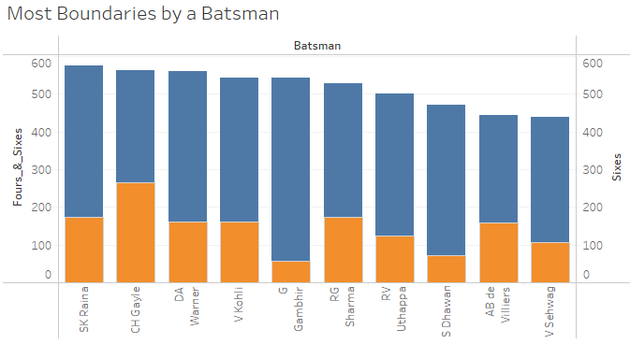
Chris Gayle has the max number of sixes and DA Warner leads with number of fours
PLAYER STATISTICS
SK Raina followed by Chris Gayle have the highest number of boundaries

Slide 6
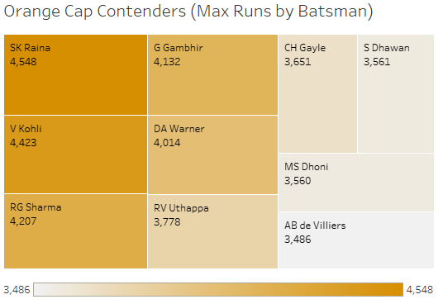
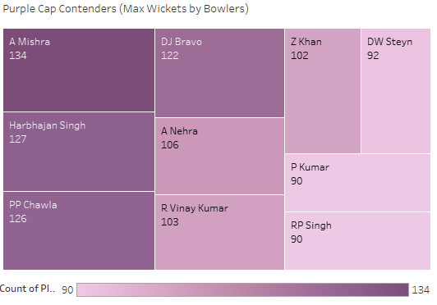
SK Raina followed by V Kohli are the top 2 contenders for Orange Cap.
PLAYER STATISTICS
A Mishra and H Singh are the top 2 contenders for Purple Cap.

Slide 7
SK Raina followed by V Kohli are the top 2 contenders for Orange Cap.
PLAYER STATISTICS
A Mishra and H Singh are the top 2 contenders for Purple Cap.

Slide 8
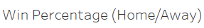
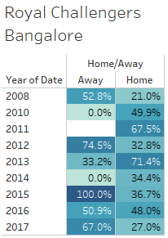
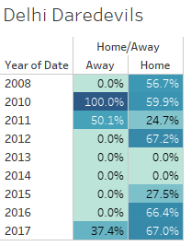
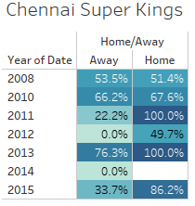
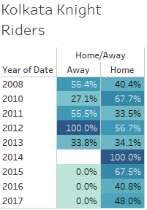
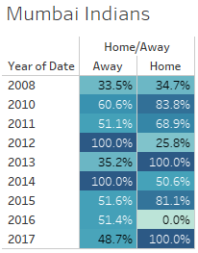
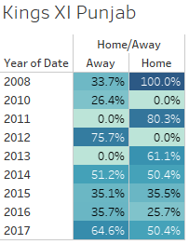
For almost all the teams the win percentage is better when playing at Home, except Mumbai which comparatively has a higher win percentage even when playing Away.
TEAM STATISTICS

Slide 9
Thank You!

